Slide 1
JOB MARKET ANALYSIS & RECOMMENDATION SYSTEM -Ankita Babar
Nexthikes IT Solutions

Slide 2
Project Overview:-
The project analyzes a large-scale dataset of job postings to understand current employment trends, salary patterns, geographical demand and remote-work opportunities.
It combines exploratory data analysis, statistical analysis, predictive modeling and recommendation techniques to transform raw job-posting data into actionable insights.
An interactive Streamlit dashboard was developed to present the results in a user-friendly and decision-oriented format.

Slide 3
Problem Statement :-
Problem Statement:-
The online job market contains a large volume of job postings with different titles, countries, salary structures and employment patterns.
Finding meaningful trends from this unstructured information manually is difficult and time-consuming.

Slide 4
Dataset & Data Preparation:-
Dataset Overview:-
244,828 Job Postings
212 Countries
205,470 Unique Job Titles
Hourly and non-hourly opportunities
Job title, country and publication information
Hourly minimum and maximum rates Job posting links
Data Preparation:-
Missing values were handled appropriately and numerical salary fields were converted into usable numeric formats.
Publication dates were standardized to enable monthly trend analysis and forecasting.

Slide 5
Challenges Faced in project:-
Large-Scale Dataset The dataset contained a very large number of job postings, making data processing computationally demanding.
Memory Limitations Converting large sparse text matrices into dense arrays caused significant memory consumption and system errors.
High Number of Unique Job Titles More than 200K unique job titles made keyword extraction and similarity calculations challenging.
Missing Salary Information Many job postings did not contain complete or usable hourly-rate information.
Recommendation Scalability Creating a complete job-to-job similarity matrix required extremely high memory for the large dataset.
Inconsistent Data Missing values, date formats and salary fields required careful preprocessing before analysis.
Future Forecast Uncertainty Predicting future job demand from historical posting patterns involved uncertainty due to changing market conditions.

Slide 6
Solutions Implemented:-
Memory-Efficient Processing Sparse matrix operations and optimized Pandas techniques were used instead of unnecessary dense conversions.
Efficient Text Processing TF-IDF and keyword-based techniques were applied to process thousands of job titles efficiently.
Optimized Recommendation Approach Query-based similarity was used instead of generating a massive job-to-job similarity matrix.
Data Cleaning & Transformation Missing values were handled, dates were standardized and salary columns were converted into numerical formats.
Valid Salary Filtering Salary analysis was restricted to postings containing reliable hourly-rate information.
Monthly Aggregation Job postings were aggregated by month to reduce noise and identify meaningful market trends.
Predictive Modeling Historical trends were used to generate future demand estimates and multiple possible market scenarios.

Slide 7
Integrated Streamlit Dashboard:-
Interactive Job Market Intelligence Platform:-
The complete analytical workflow was integrated into a Streamlit-based dashboard to make the project interactive and accessible.
Dashboard Capabilities:-
Executive KPI overview
Country filtering
Job-title analysis
Monthly trend analysis
Salary intelligence
Remote-work insights
Recommendation engine
Future forecasting

Slide 8
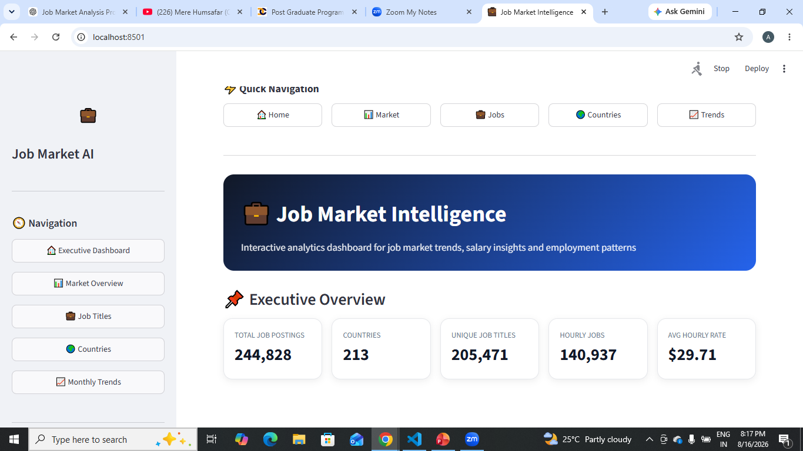
Streamlit Dashboard:-
Analysis:-
Job postings were aggregated by month. Monthly trends were visualized. Changes in posting activity were examined. The dashboard enables interactive exploration of market dynamics.

Slide 9
Project Tasks & Deliverables:-
Task 1 — Salary & Keyword Analysis
Analyzed job-title keywords and their relationship with offered hourly salaries to identify high- and low-paying keyword patterns.
Task 2 — Emerging Job Categories
Identified frequently occurring and emerging job categories by analyzing job-posting frequency and category trends.
Task 3 — Demand Forecasting
Forecasted the future demand of the top 5 job categories using historical job-posting patterns and predictive analysis.
Task 4 — Geographic Salary Analysis
Compared job opportunities and available hourly-rate patterns across different countries to understand geographical market differences

Slide 10
Task 5 — Job Recommendation Engine
Developed a recommendation system using text similarity to suggest relevant job opportunities based on a user's search query.
Task 6 — Monthly Market Dynamics
Tracked monthly changes in job-posting activity to identify market fluctuations and changing employment trends.
Task 7 — Remote Work Analysis
Analyzed remote-work opportunities and compared remote versus non-remote job patterns to understand the changing work landscape.
Task 8 — Future Job Market Prediction
Used historical trends to forecast future job-market activity and created optimistic, baseline and conservative future scenarios.

Slide 11
Business Insights & Recommendations:-
1. Skill Demand
Frequently appearing job-title keywords indicate areas with stronger market activity.
2. Salary Intelligence
Salary patterns vary across roles and geographical markets where hourly-rate data is available.
3. Geographic Opportunities
Job-posting concentration differs significantly across countries.
4. Remote Work
Remote opportunities represent an important dimension of the modern employment landscape.
5. Predictive Planning
Forecasting can help candidates and organizations prepare for potential changes in job demand.

Slide 12
Recommendations:-
Job seekers should focus on high-demand skills. Recruiters can monitor emerging categories. Organizations can use geographical salary patterns for planning. Candidates can use recommendation scores to discover relevant opportunities.

Slide 13
Conclusion:-
The project successfully transforms raw job-posting data into meaningful market intelligence through analytics, visualization and predictive techniques.
It provides insights into job demand, salary patterns, geographical opportunities, remote work and future market trends.
The Streamlit application makes these insights interactive and easier to explore.

Slide 14
Thank you!!

